Slide 1
Getskills SOAPUI tRAINING

Slide 2
How to set up a SOAPui Project ?
There are several ways to install SOAPUI and setup a project.
Install the latest SOAPUI tool from http://www.soapui.org/Getting-Started/installing-soapui.html
Latest version is available
If you have any development tool (e.g. Eclipse) you can install the plugin available in the eclipse market. The SoapUI eclipse plugin provides full SoapUI functionality from within eclipse. Apart from "standard" SoapUI 2.5 functionality, the eclipse plugin contains a SoapUI project nature and also adds a new SoapUI perspective which mimics the layout of the standalone SoapUI version. Steps are below :
An eclipse update site is now available at http://www.soapui.org/eclipse/update, install the soapui-eclipse-plugin with the following steps:
1. Select Help > Install New Software...
2. In the Work with field, type http://www.soapui.org/eclipse/update and click Add…
3. entering the SoapUI update site in eclipse.
4. Check the SoapUI checkbox and click Next. Then follow the dialogs to install the SoapUI feature

Slide 3
SETUP PROJECT CONTINUE…..
step-by-step process :
The SoapUI project is the central point in all SoapUI testing. Once the project is created, you can create and run Functional Tests, LoadTests, create MockServices or much more. In this tutorial, we will walk through two things how to:
Create a SOAP project
Add a WSDL
1) Create a SOAP project
In the navigator, which is the tree structure at the left in the SoapUI GUI, right click on the project node Image of Project Node
and select New SOAP Project

Slide 4
CONTINUE………
This will open a New SOAP Project Dialog.
(Note: you can also do ctrl+n (win) or cmd+n (mac) to open a new SOAP Project
In the New SOAP Project dialog enter a project name and click OK)
This will create a new project in the Navigator.
Congratulations, you've just created your first SoapUI Project.
Lets add WSDL now..
In SoapUI the SOAP projects are mostly based on a WSDL. It’s not necessary to start by importing a WSDL, but it makes testing easier since the WSDL contains all information you need about the web service tested; information about the requests and responses, what they contain and much more, which simplifies SoapUI testing greatly.
Let’s add a WSDL to the project;
Right click on the project node and select Add WSDL

Slide 5
The Add WSDL dialog will now open.
Enter
(Note that this has been removed. Check the top of this article for other alternatives)
http://www.mobilefish.com/services/web_service/countries.php?wsdl
Click OK.
You should now see that the WSDL was successfully added to the project by seeing the operations in the Web Service in the navigator.
You can double click the Project for a window that gives you overview of your project. As your project and test skills grow, this view will be very important since you can manage a great deal of things at project level, like JDBC Connections (SoapUI Pro only), Security Configurations. SoapUI even contains basic Requirements functionality in the Project Window.

Slide 6
How to set up Properties at Project, TestSuite, Test case and Test step levels?
soapUI makes frequent of custom properties for storing custom values within a Project. A "property" is a named string value (currently all properties are handled as strings) that can be accessed from a Script, a Property Transfer or a Property-Expansion references. soapUI allows for the definition of properties at multiple levels within the project hierarchy;
Projects : for handling Project scope values, for example a subscription ID
TestSuite : for handling TestSuite scoped values, can be seen as "arguments" to a TestSuite
TestCases : for handling TestCase scoped values, can be seen as "arguments" to a TestCase
Properties TestStep : for providing local values/state within a TestCase
Local TestStep properties : several TestStep types maintain their own list of properties specific to their functionality : DataSource, DataSink, Run TestCase
MockServices : for handling MockService scoped values/arguments
MockResponses : for handling MockResponse scoped values
Global Properties : for handling Global properties, optionally from an external source

Slide 7
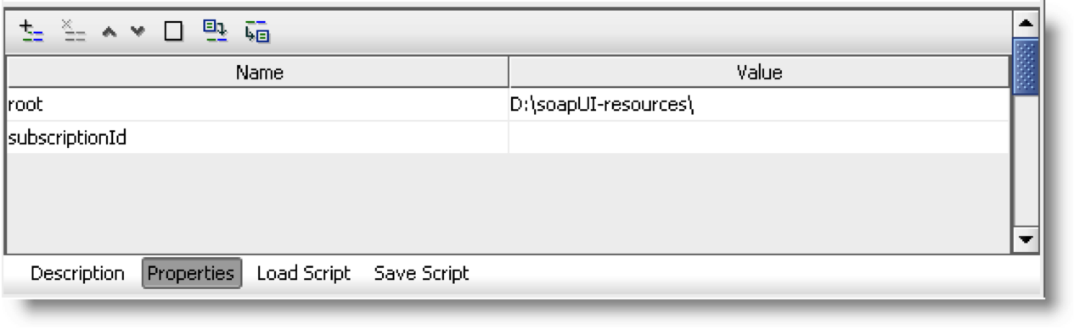
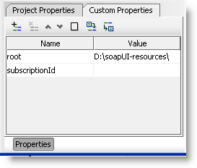
Continue………
Properties are generally editable in three places:
From the selected objects main editor window in a Properties inspector:
From the selected objects Details tab (bottom left) in a Test Properties tab

Slide 8
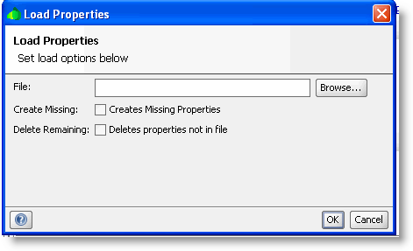
Continue……
From the navigator itself when in Property_Mode.
The table available in the first two options has buttons to Add, Remove, Move Up and Down, Clear and Load properties from an external source as well as Save properties to a file. Loading properties has additional options of handling specific properties from a file, and properties already defined on soapUI objects.
In the table both names and values of properties can be edited as desired.
When renaming a property, soapUI will attempt to refactor all references to that property in both Property Expansions and Property Transfers.

Slide 9
How to do Property Transfers between SOAP Response to SOAP Requests ? You will need this in scenarios where you test a Modify Service after running a test of Create Service.
Property Transfer TestSteps are used to transfer properties between TestSteps and their containing TestCase, TestSuite and Project. They are extremely useful in a number of situations, especially when properties containing XML are involved, for example when you need to
Extracting a value from an XML message, for example a sessionID from a SOAP Response
Write a value into an XML message, for example a saved sessionID or authentication data
Transfer complex XML content between properties
etc
Lets get to grips!

Slide 10
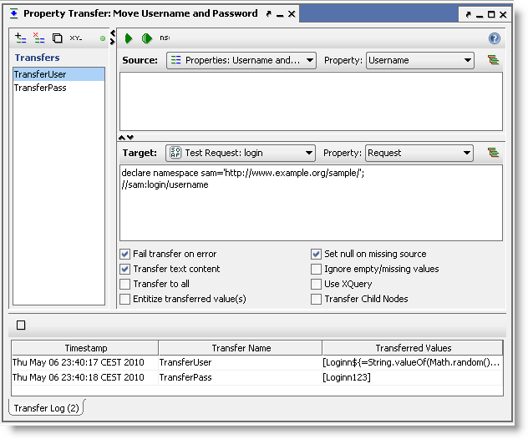
Creating or double-clicking an existing Property-Transfer TestStep opens the following window:
The list to the left shows you the configured transfers in this TestStep, add and manage as many as you want. When selecting a transfer (like the "TransferUser" in the screenshot above), the area to the right allows you to configure it as desired;
The Source area at the top specifies the source property and optional XPath for the transfer
The Target area under that specifies the target property and optional XPath for the transfer
The area below that holds different configuration options set on a transfer to transfer level.
The Transfer Log at the bottom shows the latest executed transfers while the window was open and their actual transferred values.
The available configuration options can drastically change what is transferred and their respective is defined as:
Fail transfer on error - The transfer step will fail in case any errors happen while attempting to perform the transfer
Transfer text content - Only text content will be transferred. No structural elements will be preserved

Slide 11
Transfer to all - The matched values will be transferred to all the target locations in case there are several that matches
Entitize transferred values - The values will have certain characters for example ampersand ("&") replaced with it's corresponding character entity value ("&")
Set null on missing source - The target will be set to null in case the source resource is missing. This means that if the target already has a value it will be lost
Ignore empty/missing values - This means that if the matched value of the source is empty or missing it will be ignored and the target value left untouched
Use XQuery - SoapUI will assume that the source is XQuery rather than the default XPath when trying to extract the source values
Transfer child nodes - SoapUI will not attempt any textual extraction from the matched source node but rather pick the children of the matched node and thus preserving the subtree XML structure

Slide 12
An example: transfering a session ID from a response to a following request
This is a very common scenario, lets do a step-by-step walkthrough. Lets say we have a login service that returns a sessionID that we subsequently want to use to authenticate; a property-transfer is perfect for extracting the sessionID and writing it to a property that can then by referred to by all desired TestSteps. Here we go:
Add and execute the login request to an empty TestCase so you have a valid response to work with;

Slide 13
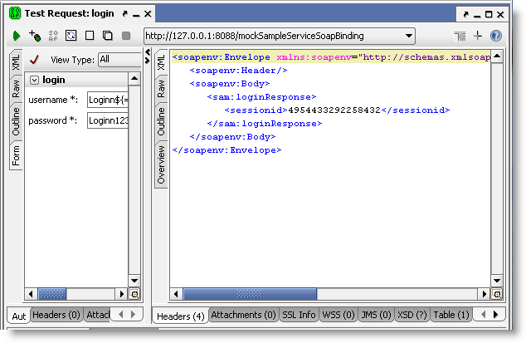

Slide 14
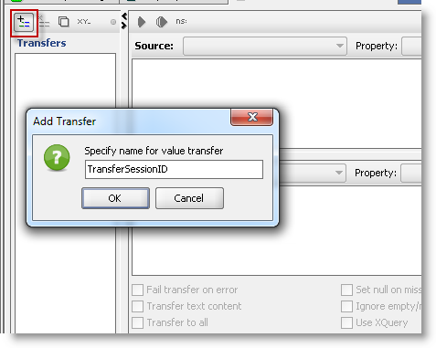
Create the Property-Transfer TestStep after the request and add a property-transfer to it;

Slide 15
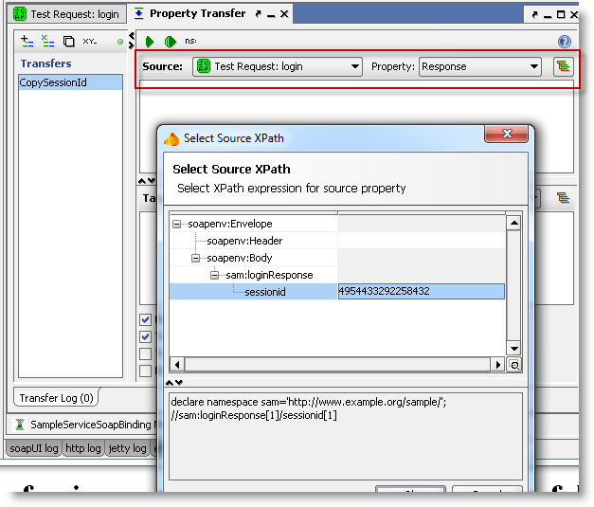
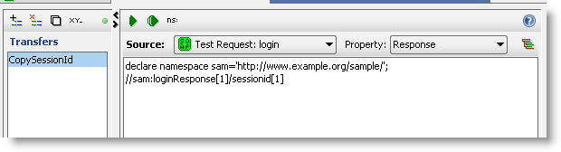
Configure the source-property to be the Response of the Login Request and then select the "Wizard" button to the right on the source property toolbar. This opens a convenient wizard for selecting the desired source node to transfer from (in standard soapUI you will have to manually create the generated XPath statement).
1
Select the node and press OK; soapUI generates the corresponding XPath statement for you;
2

Slide 16
Now the source is all set up and your next step is to configure the target for the property-transfer, ie where it should be written. We have two options;
write it to a temporary property that can be referred to by all subsequent TestSteps that need to use the sessionID. This is the best solution if we want to use the sessionID in several places or TestSteps
transfer it directly to the target TestStep(s) where the value should be used. This is easier if you just want to use the value in one place
Lets have a look at both of these

Slide 17
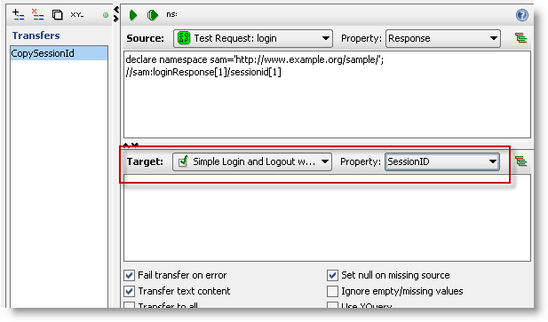
Writing to a Temporary Property
Lets save the property to a TestCase property that we have defined with the name "Session ID";

Slide 18
Now when executed, the SessionID is transfered to the specified TestCase property and can later on be used in any request via standard property-expansion (or another property-transfer), for example in a logout request we could have
<logout>
<sessionID>${#TestCase#SessionID}</sessionID>
</logout>
Which would replace the expansion with the saved SessionID when the request is being sent.
Writing directly to the desired target TestStep
This is more straight-forward; set the target to be the logout request and use the XPath Wizard again (or your XPath skills) to create the target XPath statement;

Slide 19
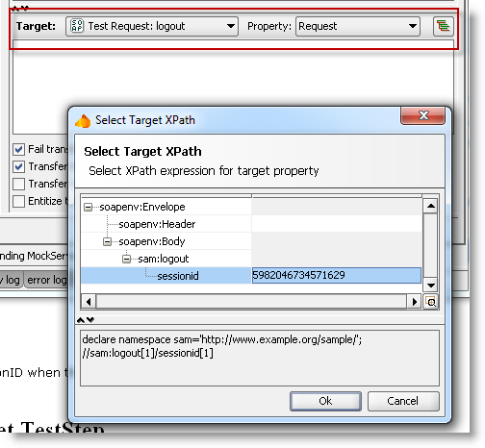
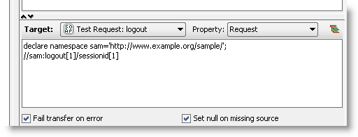
1
resulting in
2
Now when executing this, the source target value will get directly extracted from the response and written into the request message.

Slide 20
How to set up Assertions and what does each assertion in SOAPui mean?
Assertions are checks that what you receive is what you expected to. An example; I have a Web Service where I search for a product by product id. In the response i expect the same product id in the field named product id. If I do manual testing, I send the request and then look for the matching id in the response. This is what we call asserting. As you can see assertion is an integral part of testing, yet quite a fair share of testing in testware is done without assertions, and we'd like you to get into the habit of performing them in SoapUI. An example of an assertion would be to say, “If the response contains the company name eviware, the service I’m testing seems to work”.

Slide 21
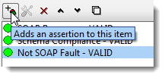
Creating assertions is real simple in SoapUI; you create them by going to the Assertion Tab assertion-tab-soapUIin the SoapUI request/response editor.
Creatin an new assertion in SoapUI when doing a functional testIng the editor you click the button for New Assertion and then choose which type of assertion you would like. At first you can start off with a very simple assertion like the Contains assertion, which checks the entire response for a text, and then quickly moves to the more accurate XPath assertion (look at SoapUI Pro, the XPath assertions are real simple there), where you check for a text in a certain element in the response. The Contains assertions says "I want the text 'eviware' to be in the response", while XPath says "I want the text 'eviware' to be in the Company Name element response".

Slide 22
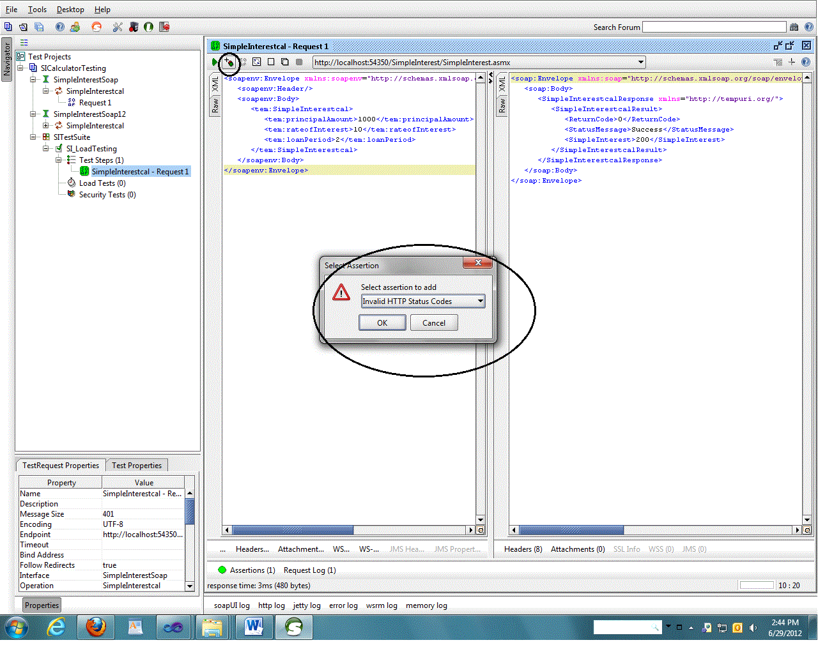

Slide 23
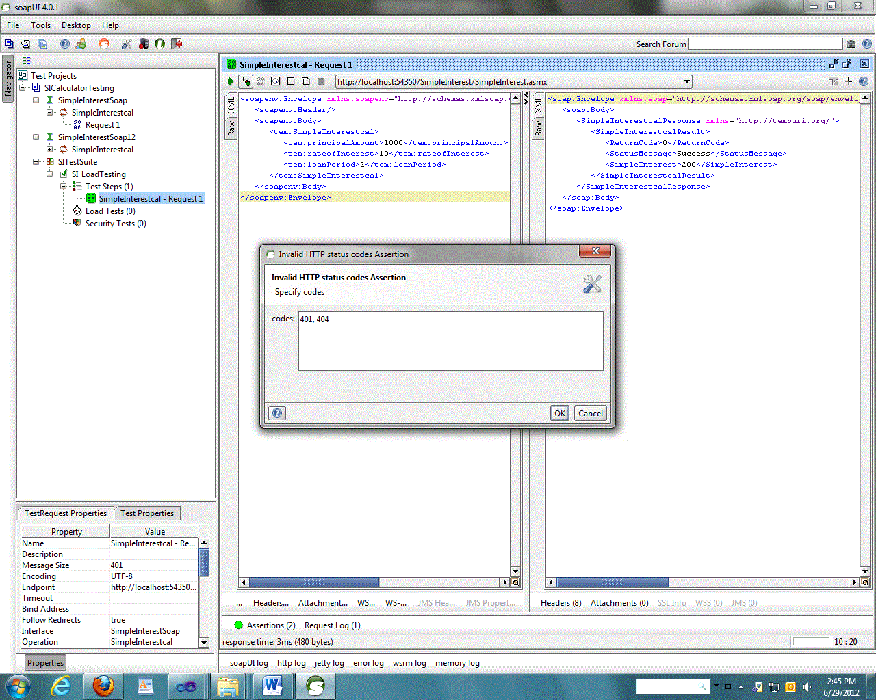
Select the invalid HTTP Status code and click OK.
This will open a small window where we can specify the code that we want to check.
Give 401 (unauthorized), 404 (Not found) etc. and as many as you required and click OK.

Slide 24
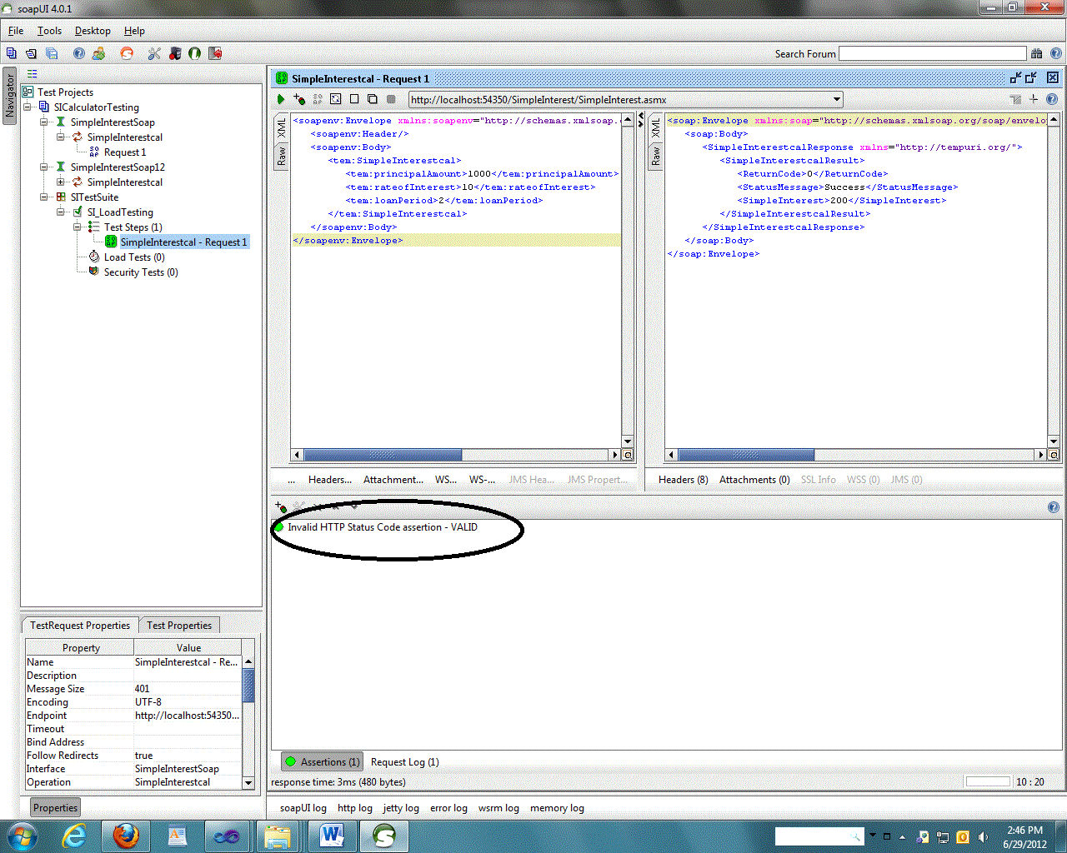

Slide 25
Assertion categories
Assertions are divided in several categories for easier managing. Only categories that contain applicable Assertions for specific type of sampler are enabled. In case of AssertionTestStep only categories that contain applicable Assertions for selected Source/Property combination are enabled ( please check http://www.soapui.org/Functional-Testing/assertion-test-step.html ). Same goes for enabling/disabling particular Assertion inside the category.
In addition under the Categories there is "Recently used" category which lists 5 Assertions most recently used, some of which may also be disabled for particular Source/Property selected.
All available Categories with containing Assertions are listed below.
Property Content Category
Contains - Searches for the existence of a string token in the property value, supports regular expressions. Applicable for any property.
Message Content Assertion - Allows for complex content validation of XML messages. Applicable to any property containing XML.
Not Contains - Searches for the non-existence of a string token in the property value, supports regular expressions. Applicable to any property.
XPath Match - uses an XPath expression to select content from the target property and compares the result to an expected value. Applicable to any property containing XML
XQuery Math - uses an XQuery expression to select content from the target property and compares the result to an expected value. Applicable to any property containing XML

Slide 26
Common Assertions
A large number of assertions are available for validating received messages, some being specific for a certain type of TestStep and some being common for all TestSteps. The assertions available for all TestSteps are:
Contains - checks for the existence of a specified string.
Not Contains - checks for the non-existence of a specified string.
Reponse SLA - check the response time against a specified value.
XPath Match - compares the result of an XPath expression to an expected value.
XQuery match - compares the result on an XQuery expression to an expected value.
Script - runs an arbitrary script that can be used to validate the received message as desired.

Slide 27
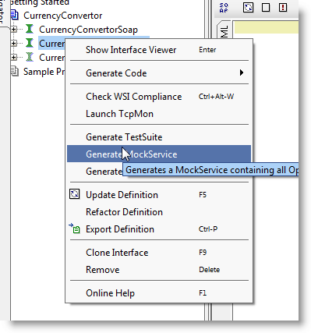
How to set up Mock Services ? You can use mock services as a stub service or in a scenario when your services are down or not developed yet.
Creating a mock service
Right-click on one of the SOAP interfaces and select Generate MockService.

Slide 28
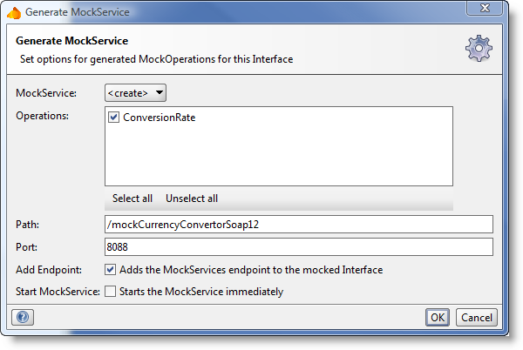
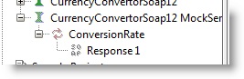
In the dialog Generate Mock Service you can specify the local port/path for the service you're creating but for the moment just click OK.
Enter the name of your MockService in the Name dialog and click OK.
After creating the MockService, you should get a MockService with one operation and one request.

Slide 29
How to Integrate your soapui project with Microsoft Excel ? This is the must do for setting up your Automation framework
Read data from excel in soapUI like a database
Treating Excel as a database is one of the most popular method used in automation testing. Web services testing is also not much different than that. There might be instances that we might need to treat an excel sheet as a database and read data from this excel sheet in soapUI for data validation or input data or for configuration purposes. In this example, instead of relying on groovy, we will be using a bit of java code to connect to an excel sheet and read data from this excel sheet. In order to connect to an excel as a database, we need a driver. We will be using "sun.jdbc.odbc.JdbcOdbcDriver" in our example to connect to an excel fom soapUI. Lets say we have a file named "soapUI-Excel-Example .xls" and it has a work sheet named "ExcelSheetName". Now, create a coulmn named "Name" in the sheet and enter some data in the column. Its time for us to look into the code now. Lets see the below example on how to connect to excel from soapUI.

Slide 30
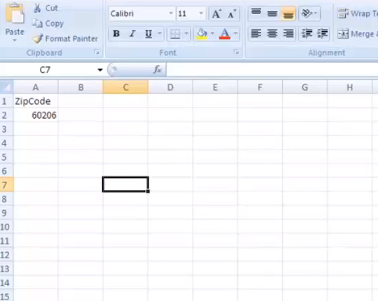

Slide 31
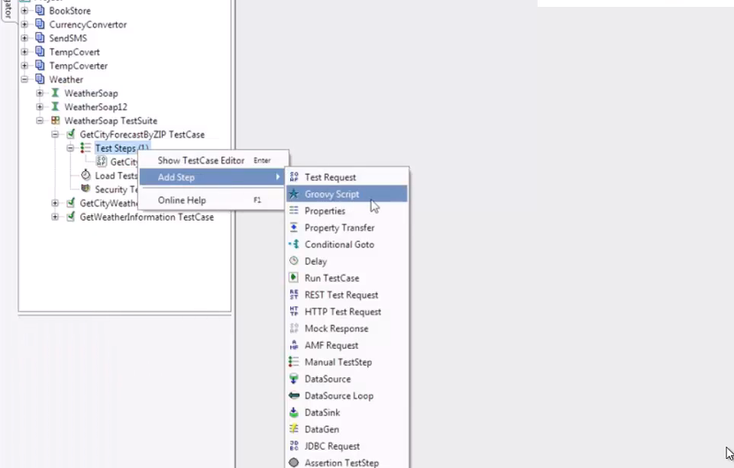

Slide 32
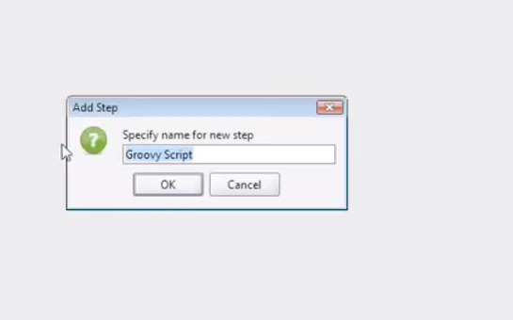

Slide 33
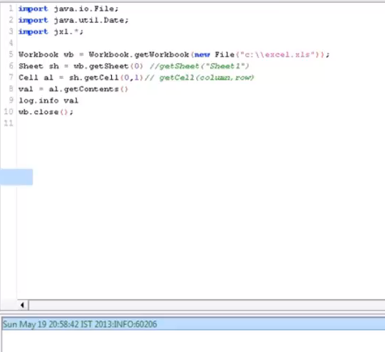

Slide 34
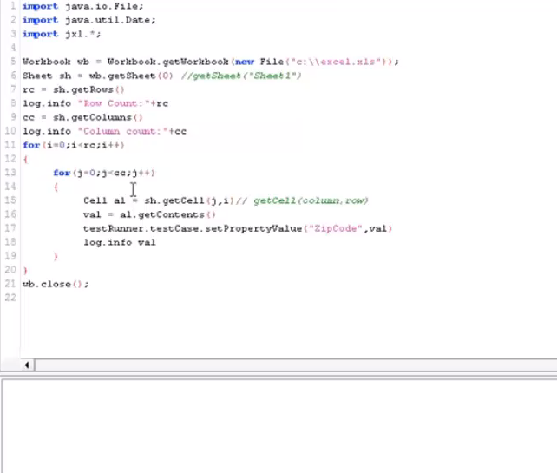

Slide 35
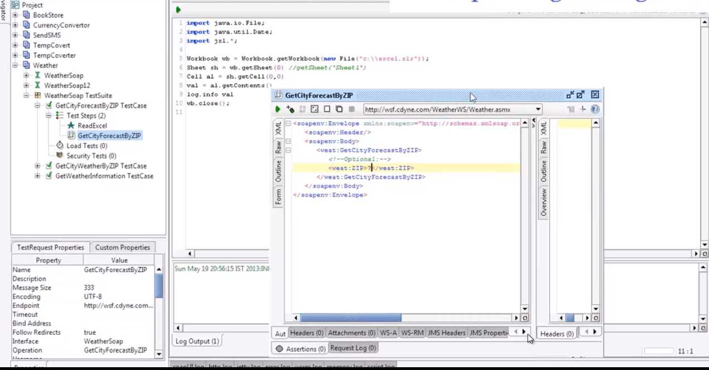

Slide 36
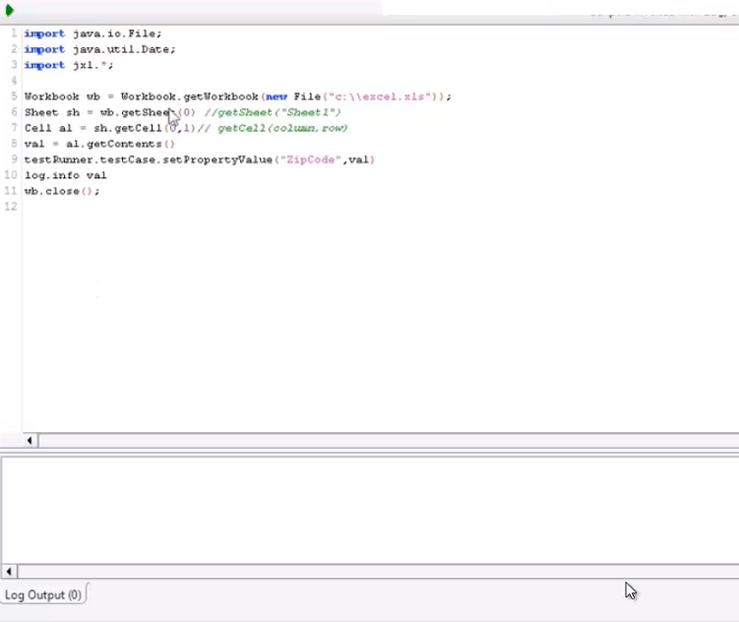

Slide 37
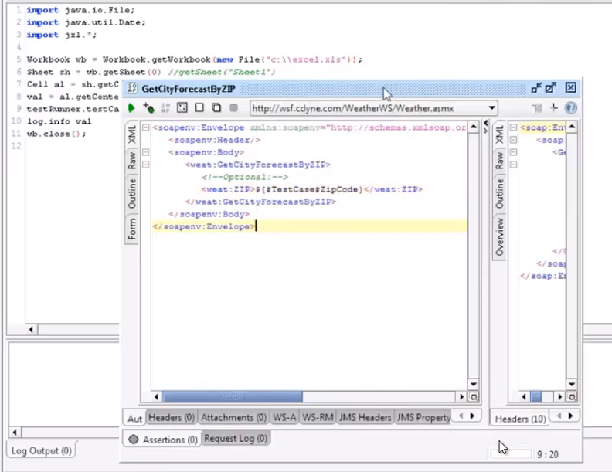

Slide 38
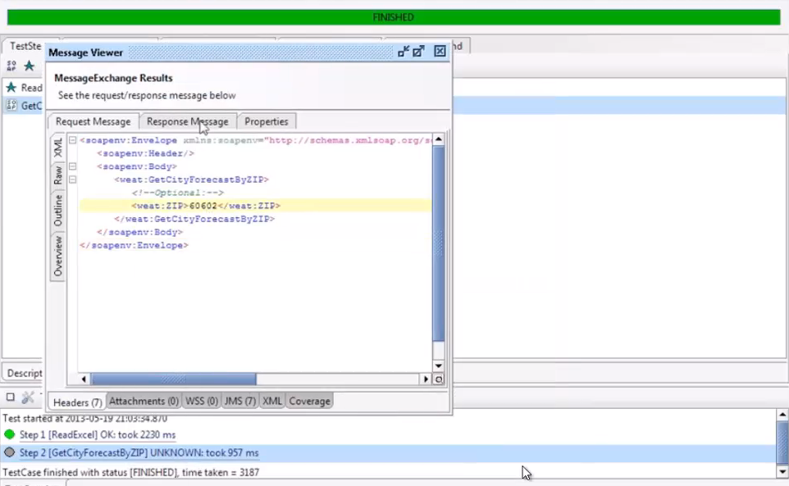

Slide 39
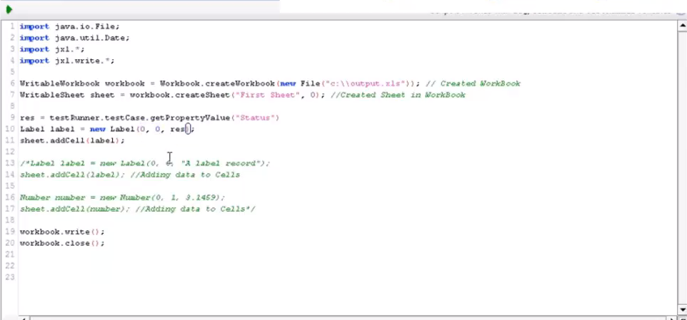
HOW TO PRINT BACK TO EXCEL ?

Slide 40
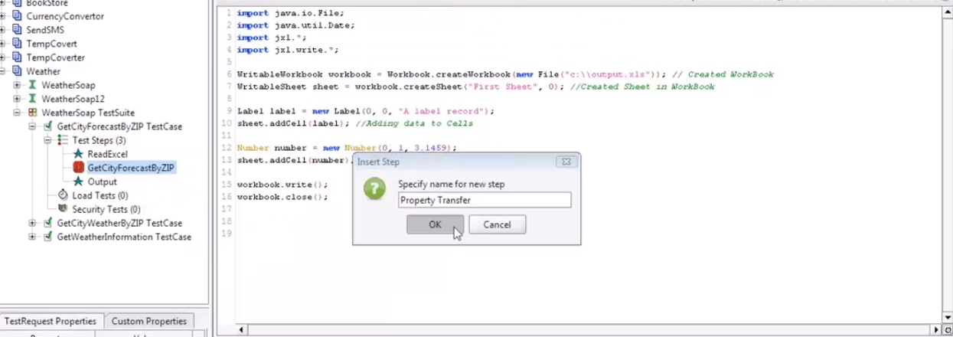

Slide 41
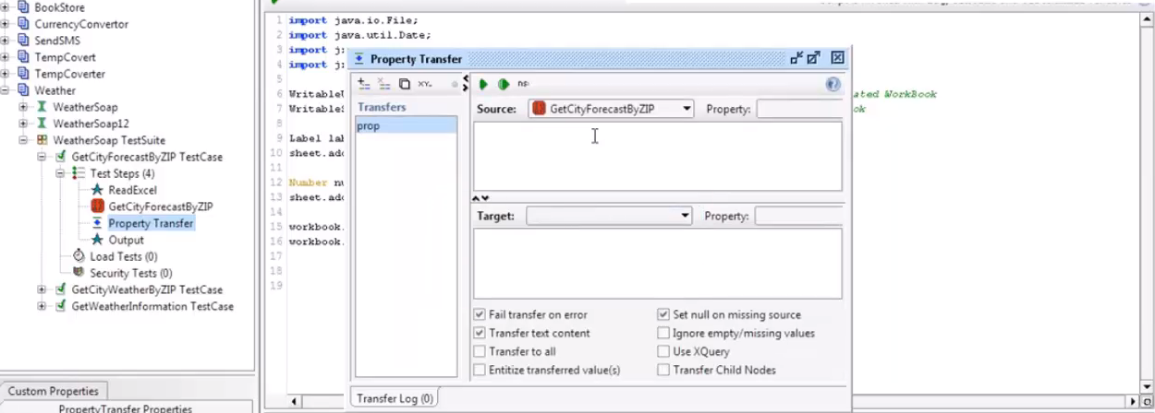

Slide 42
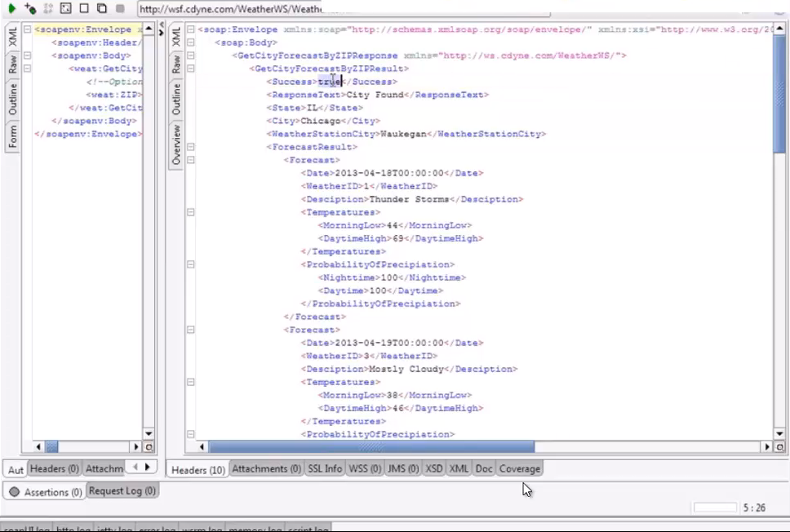

Slide 43
Groovy Scripting Fundamentals and how to use Groovy to build your SOAPui based automation framework. SOAPui understands only Groovy scripting language and understanding the exact syntax and methods to use can save you a lot of development time.

Slide 44
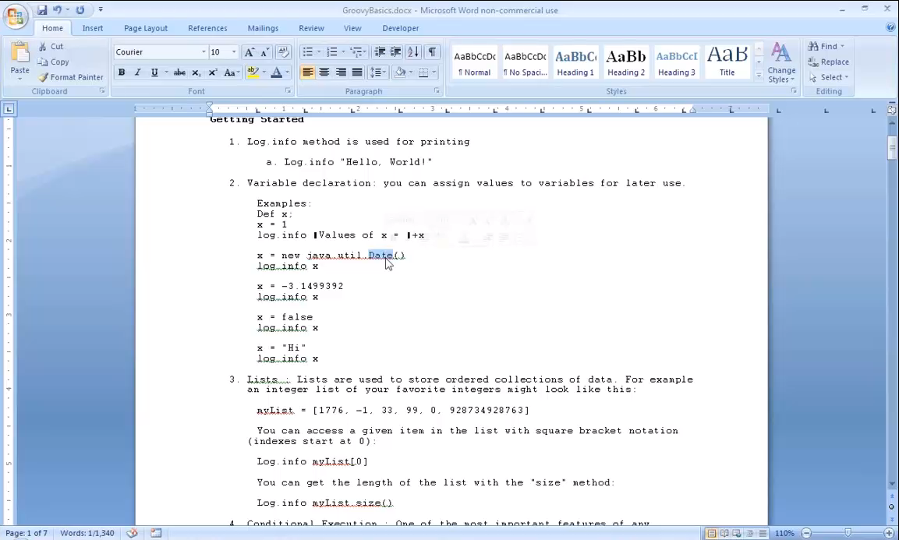

Slide 45
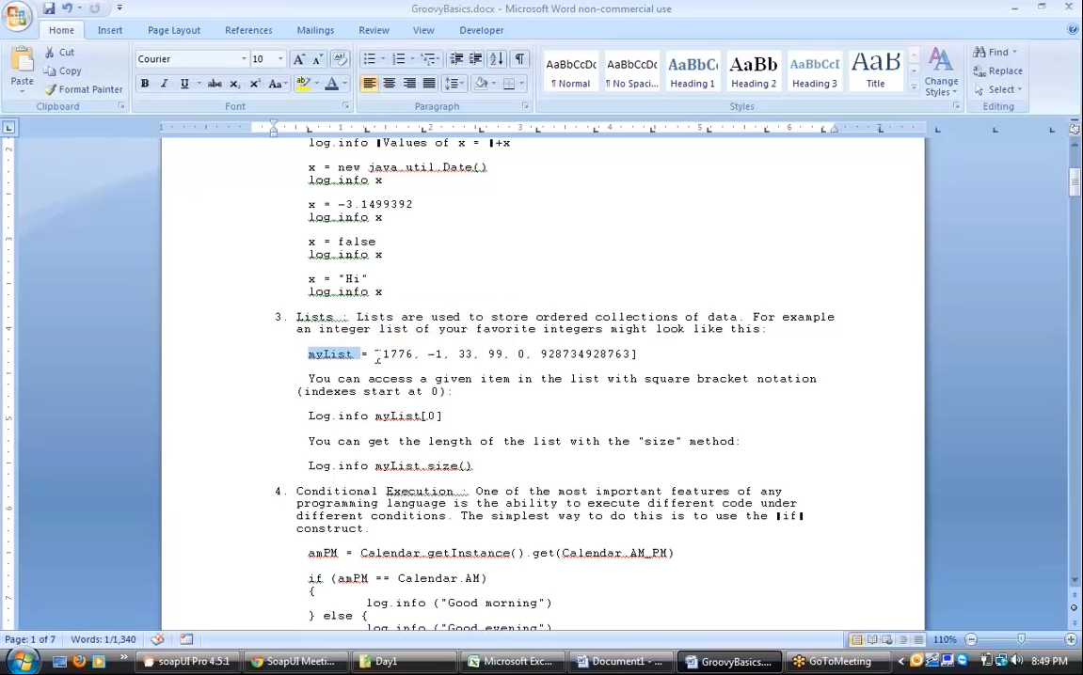

Slide 46
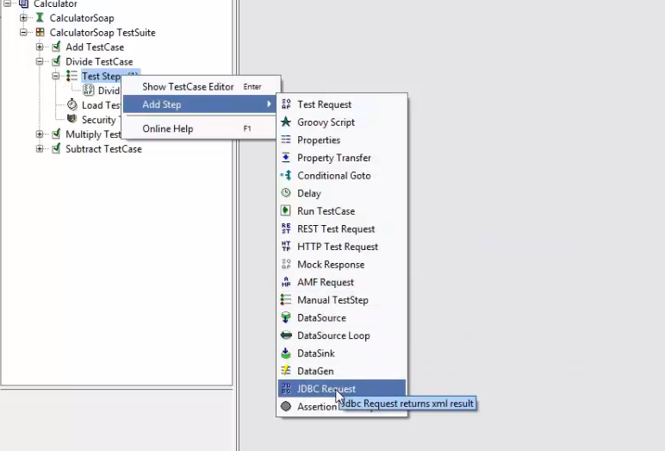
How to connect to database from SOAPui to validate the test result data ?

Slide 47
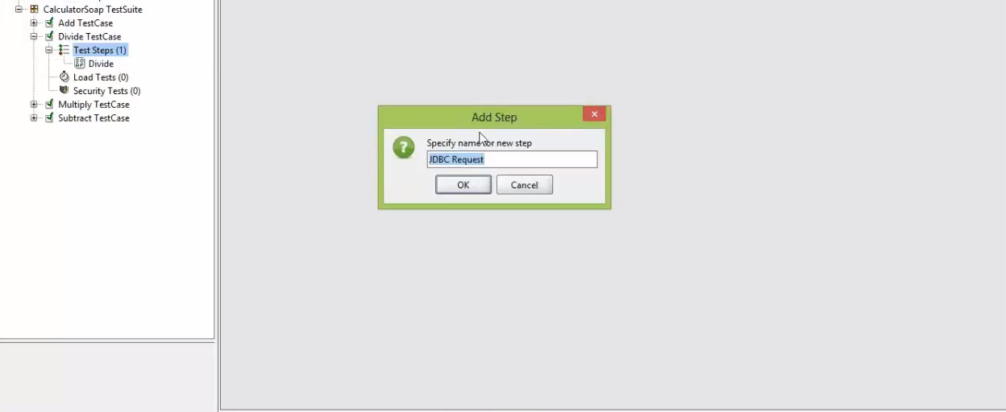

Slide 48
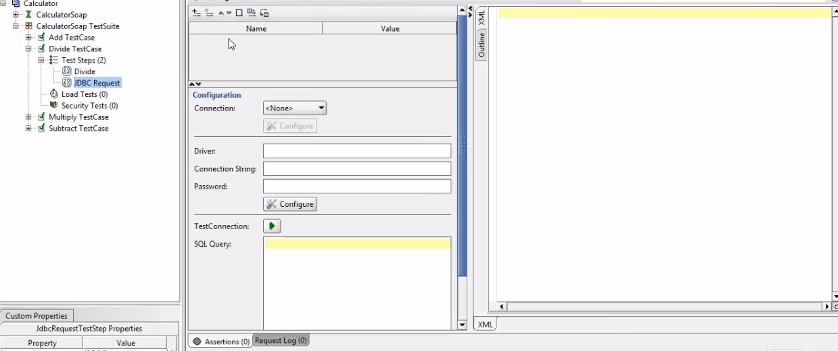

Slide 49
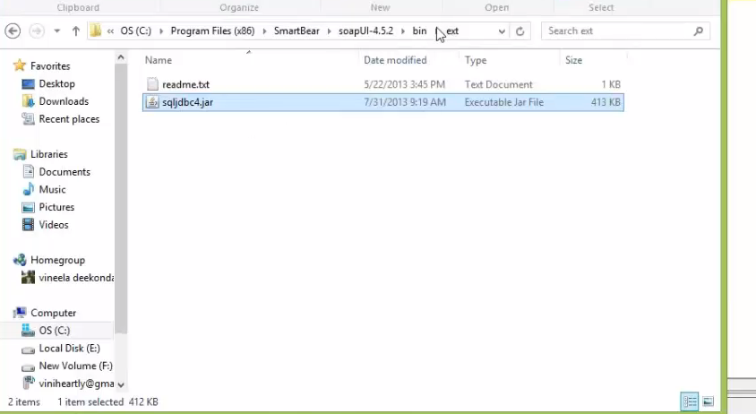

Slide 50
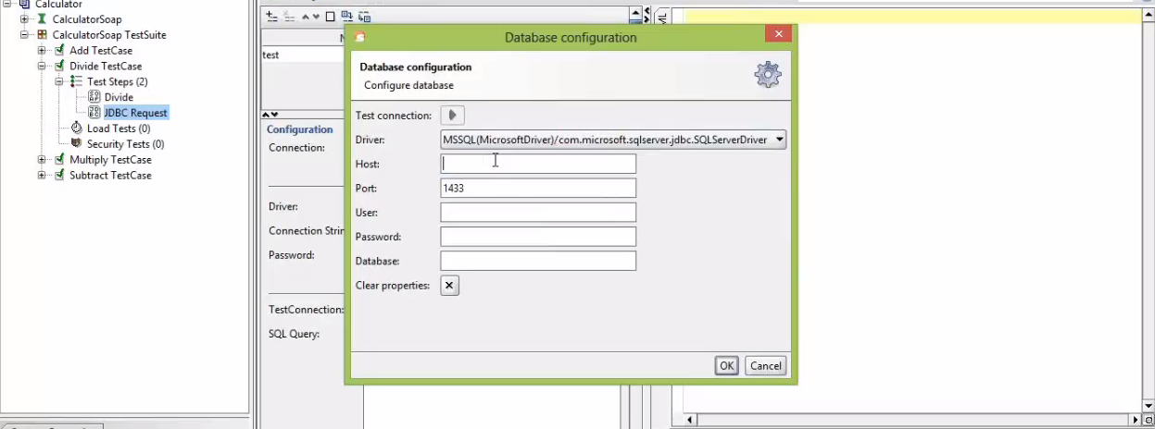

Slide 51
